Slide 1
Project Amazon Sales Analysis

Slide 2
Objective . Development of predictive model for predicting sales. . Perform ETL (Extract-Transform-Load) on dataset. . Develop dashboard by using Power bi. Benefits . Better understand and optimise revenue generation in future . Maximize forecasting accuracy . Make current sales experience our top priority

Slide 3
Data Preprocessing : . Importing necessary libraries for data analysis such as pandas, numpy , matplotlib, seaborn etc . Using pd.read_csv() function stores the data in pandas dataframe named df . Using df.column showing columns present in dataframe . Info() function shows basic information of dataframe like null values, count of each column and their data type . Changing the datatype of different column for model training and analysis . Using describe() function on dataframe for getting basic stats of numerical dataset

Slide 4
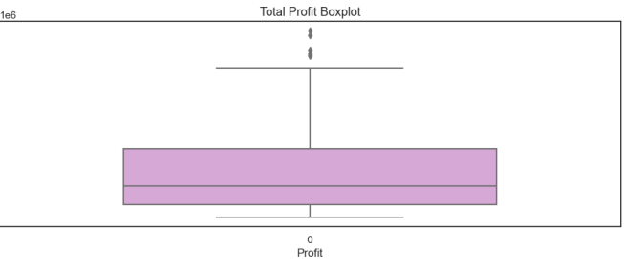
Exploratory Data Analysis Checking Outliers in the dataframe by using Box Plot . Box plot for total profit: Here we detect outliers in the specified column using the Z-score method and found 7 outliers

Slide 5
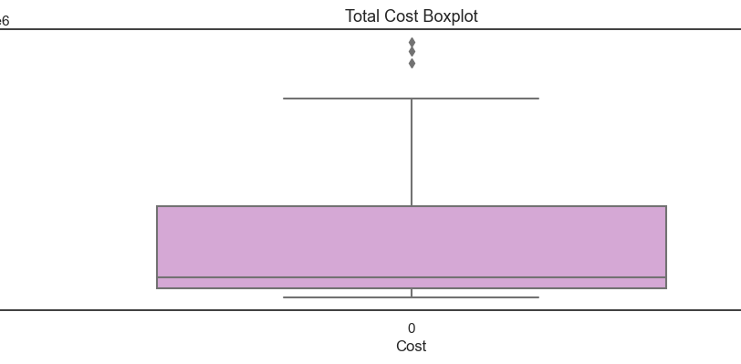
Box Plot of Total Cost: Found 5 Outliers in Total Cost column

Slide 6
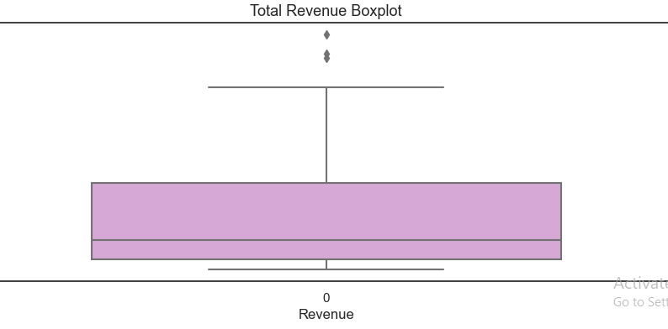
Box Plot of Total Revenue: Found 6 Outliers in Total Revenue column

Slide 7
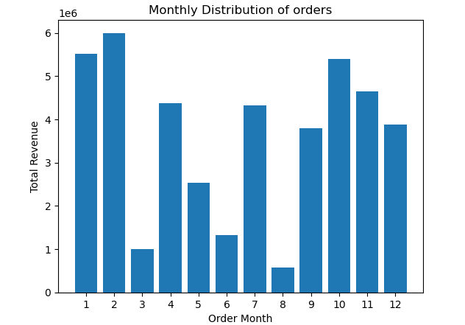
Creating a bar chart for Total Revenue and Order Month: Where it showcases the number of order purchased in particular month

Slide 8
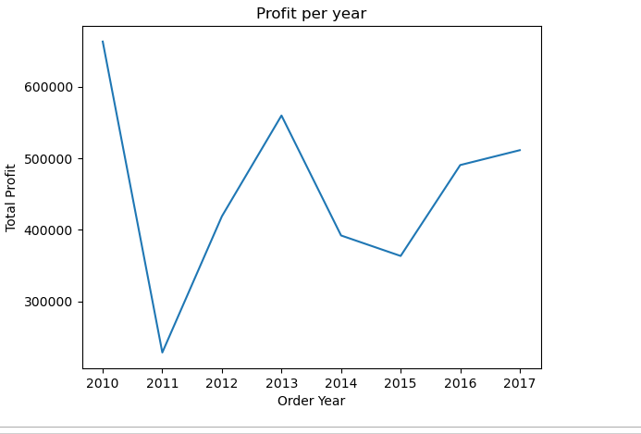
Ploting line graph of Total Profit and Order Year: Where it showcases the Profit per year

Slide 9
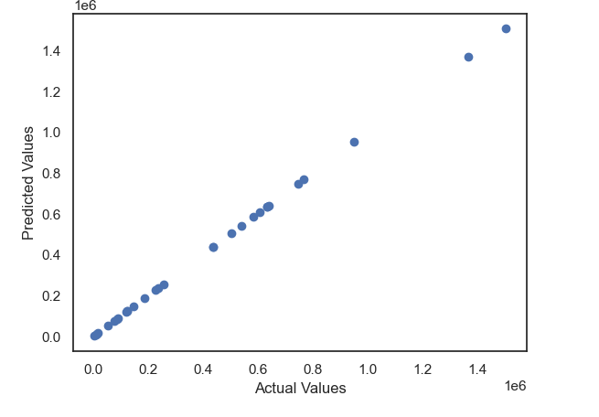
Plotting the predicted values against the actual values to visualize how well the model is fitting the data

Slide 10
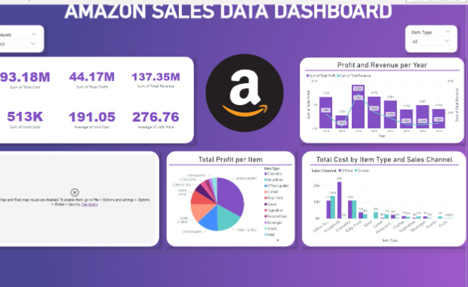
As we can see in the Dashboard most of the Profit and Revenue is generated in year the year 2012 We can also see that cosmetics is the item type which is giving us more profit. In the month of June we are getting more Profit

